Slide 1
Review Poster

Slide 2
Background
Physical systems can present non-stationary behaviour, engaging in different operating conditions (modes).
Several solutions have been proposed for the control of known operating conditions of non-stationary physical systems.
Real-time adaptation to unknown operating conditions (not considered at design stage) is still an open problem.
Tal vez habria que expander un poco en dos sentidos.
1-En model-based methods se han considerado approaches principalmente para lidiar con los possible operating modes at design stage.
2-En data driven methods la literature a revisar es meta-reinforcement learning que propone esta misma idea de adaptarse a tasks. Solo que en la mayoria de los casos la adaptacion viene necesaria de que cambia la function objetivo y no la dinamica del Sistema.
*en ambos casos ser cuidadoso y no generalizar en ningun statement.

Slide 3
Problem statement and assumptions
Given 1) a piecewise LTI system with fully parameterizable dynamics 2) controlled by a multimodel adaptive control law and, 3) an operating condition given by a parameter change function unknown at design time (unknown operating condition):
compute a control configuration with performance guarantees given by a bounded cost function before the system enters an unrecoverable state.
Hay que definer que es undercoverable state

Slide 4
Proposed contribution
Given a multi-model adaptive control as a basis framework for known operating conditions control, we propose the design of an online learning-based, control tuning methodology for unknown operating conditions in non-stationary systems combining knowledge of system physics and behaviour with data generated.
Benchmarks
Cartpole
Quadcopter
Underwater Vehicle

Slide 5
Problem statement and assumptions
Assumption 1: All system configurations (known and unknown) can be characterized by a vector of system parameters.
Assumption 2: The impact of the transitions (change of operating conditions) on system performance is recoverable in a finite amount of time.
Assumption 3: All system configurations can be controlled with performance guarantees, by a set of control laws for which control parameters lie within a convex region.

Slide 6
Proposed approach
We present the problem of unknown operating condition control in two steps: detection of unknown operating conditions and control tuning (parameter estimation).
Detecting unknown operating conditions
We have proposed a data driven approach to detect transtitions from known system behaviours to unknown system behaviours using a system trace as input.
Latent space representation of the observable space using a vanilla autoencoder.
Classifier-based mode identification and novel mode detection.

Slide 7
Detecting unknown operating conditions
We propose to extend the novelty detection algorithm to inlcude information on the system performance by providing information on a loss metric as input to the detection algorithm.
Pole angle for the cartpole benchmark.
Safety volume for the quadcopter benchmark.
We propose an algorithm to detect unknown configurations which require a shift in the stable control region.

Slide 8
Novel mode control
Reference
Multi-Controller
Control Mixing
Physical System
Novel Control Synthesis
Sensors
Multiple model adaptive control solution for known operating conditions.
Multiple low level controllers.
Learning-based control mixing.
Data-driven control synthesis for unknown operating conditions.
Reuse knowledge from control mixing by initializing novel controller search in a region close to the control produced by the control mixing block.

Slide 9
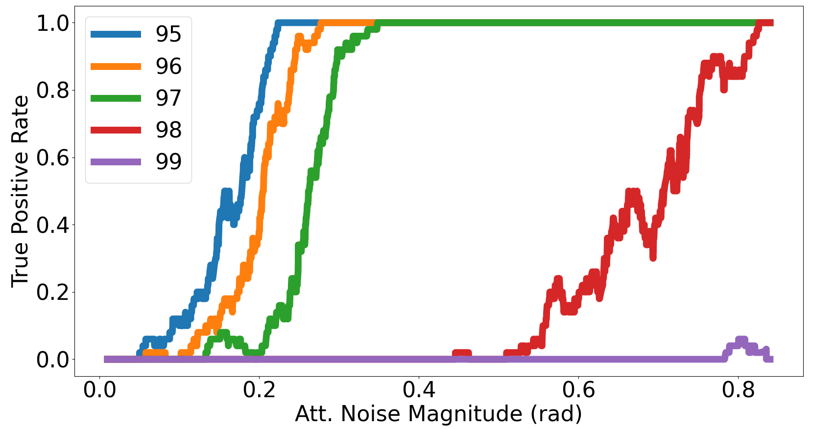
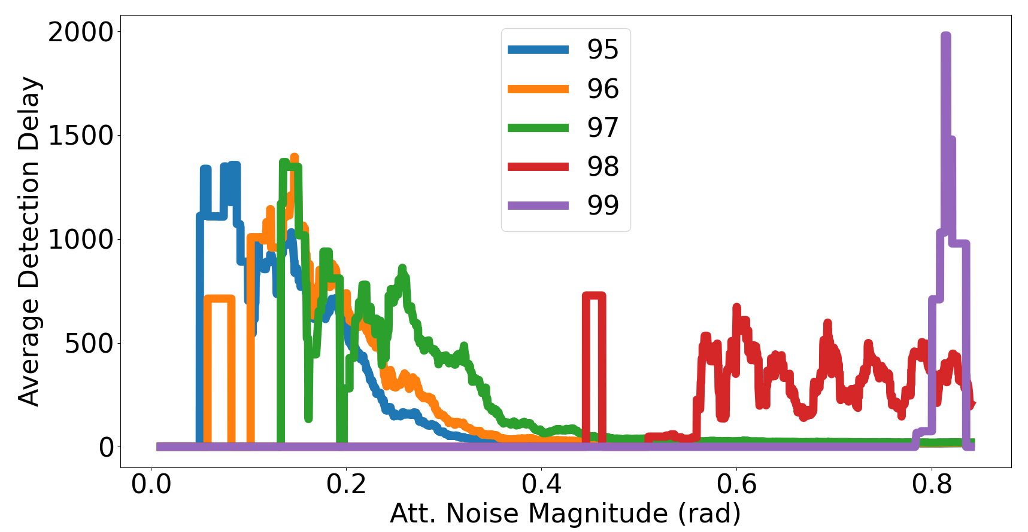
Results
We have detected transitions from known to unknown operating conditions under a multimodel adaptive control framework for the quadcopter benchmark.
Detection rate increases as the parameters of the unknown configuration deviate from the conditions considered at control design time.
Detection delay decreases as the parameters of the unknown configuration deviate from the conditions considered at control design time.

